Slide 1
Decision Support system and Executive Information System
Unit - 6

Slide 2
Introduction to DSS
A Decision Support System (DSS) is an interactive information system designed to support managers and business p-rofessionals in decision-making processes. It helps analyze data, generate insights, and solve semi-structured or unstructured problems.
Structured Decision
Routine and straightforward.
Follows a pre-specified set of steps.
Requires no judgment or experience.
Example: Calculating compound interest on a loan.
Unstructured Decision
Non-repetitive and complex.
Relies on judgment and experience.
Solutions vary between decision-makers.
Example: Developing strategies to compete in emerging markets.

Slide 3
Introduction to DSS
Semi-structured Decision
Combines structured and unstructured elements.
Some parts follow standard procedures, others need judgment.
Example: Selecting a college or university.

Slide 4
Characteristics of Decision Support System (DSS)
Key Features of DSS
Assists decision-makers in the decision-making process.
Designed to address semi-structured and unstructured problems.
Supports managers at all levels—top executives to lower management.
Provides models, simulations, and analytical tools for decision-making.
Usability and Flexibility
Interactive and user-friendly; requires minimal assistance from MIS professionals.
Easily adaptable to meet diverse decision-making requirements.
Enables rapid response to requests for information.
Flexible to accommodate varying management styles.
Supports all phases of decision-making: intelligence, design, choice, and implementation.

Slide 5
Benefits of Decision Support System (DSS)
Efficiency and Competitiveness
Enhances efficiency and speed of decision-making activities.
Boosts organizational control, competitiveness, and future decision-making capability.
Helps automate managerial processes.
Encourages higher productivity and minimizes costs.
Communication and Learning
Facilitates interpersonal communication among stakeholders.
Encourages learning and training opportunities.
Introduces new approaches and evidence for unconventional decisions.
Quality and Satisfaction
Leads to higher quality decisions.
Improves customer and employee satisfaction.

Slide 6
Applications of Decision Support System (DSS)
Solving Interrelated and Inter-organizational Problems
Interrelated Problems:
  Solutions are interconnected and influence each other.
  Requires a team of experts from diverse fields to find effective solutions.
Inter-organizational Problems:
  Involves collaboration across departments.
  Example: Launching a new product with input from design, production, marketing, finance, HR, and quality control teams.
Forecasting and Demand Management
Consolidates data from various sources for demand forecasting.
Helps determine appropriate quality and balance supply with demand.
Aids in supplier evaluation and evolution.

Slide 7
Applications of Decision Support System (DSS)
Data Integration and Decision Support
Provides comprehensive data about company projects and products for sound decision-making.
Integrates sales data to inform marketing strategies and product potential.
Additional Applications
Determining the best location for stores.
Planning and developing effective advertising strategies.
Optimizing pricing policies.
Determining an optimum product mix.

Slide 8
Components of Decision Support System
Database Management System (DBMS)
Purpose: Manages internal and external data for problem-solving.
Sources of Data:
Internal: Transaction Processing Systems (TPS) or Management Information Systems (MIS).
External: Newspapers, online data services, external databases.
Functions of DBMS:
Defining, constructing, compiling, manipulating, updating, and generating data.

Slide 9
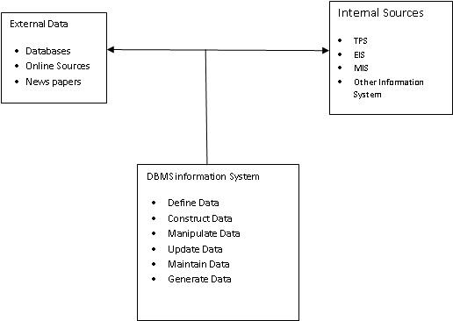
Components of Decision Support System
Fig : DBMS

Slide 10
Components of Decision Support System
2. Model Management System
Stores and manages models for decision-making.
Model Types:
Statistical Models:
  Perform statistical functions like averages, standard deviation, graphical analysis, variable relationships, and forecasting.
Financial Models:
  Analyze profit/loss, cost-benefit, and other financial measures.
Production Models:
  Address manufacturing decisions like machine operation, material requirements, and scheduling.
Strategic Models:
  Aid marketing decisions like product pricing, store location, and advertising strategies.
Human Resource Models:
  Help with manpower planning, training needs assessment, labor negotiations, and personnel forecasting.

Slide 11
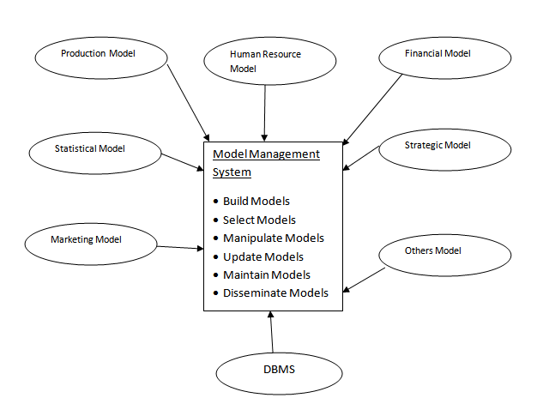
Model Builder (A tool used in Model Management System):
Allows creation, modification, and management of models.
Includes a Model Dictionary for managing metadata about models.

Slide 12
Components of Decision Support System
3. Support Tools
Purpose: Facilitate user interaction with the system.
Key Tools:
Pull-down menus, user interfaces, graphical analysis, and error correction mechanisms.
Importance of Interfaces:
Enhances user acceptance and adoption of DSS.
Overcomes lack of training in computer technologies.

Slide 13
Functions of Decision Support System (DSS)
Key Functions of DSS
Model Building
  Identifies and develops decision-making models.
  Considers input variables, relationships, assumptions, and constraints.
  Helps solve problems effectively with tailored models.
What-if Analysis
  Evaluates the impact of changes to model variables or combinations.
  Example: Assessing the effect of a 15% increase in raw material costs on future demand.
  Critical for semi-structured and unstructured problems where data may be incomplete or inconsistent.
  Enables managers to be proactive rather than reactive.

Slide 14
Functions of Decision Support System (DSS)
Goal-Oriented and Risk Assessment Functions
Goal Seeking
  Determines input values needed to achieve a specific goal.
  Helps decision-makers identify actions required to meet objectives.
Risk Analysis
  Evaluates risks and uncertainties associated with decisions.
  Classifies decisions into low-risk, medium-risk, and high-risk categories.
  Particularly useful in medium-risk and high-risk environments.

Slide 15
Functions of Decision Support System (DSS)
Visualization Function
Graphical Analysis
  Presents data using graphical charts, tables, and figures.
  Simplifies understanding of large datasets.
  Helps managers visualize the impact of various actions.

Slide 16
Tools for Developing Decision Support Systems (DSS)
DSS Generators
Programs that facilitate DSS development.
Examples:
  Data management tools
  Electronic spreadsheets
  Report generators
  Statistical packages
DSS Shells
Pre-built programs used to create customized DSS.
Features:
  Includes DBMS, model management systems, and user interfaces.
  Eliminates the need to develop these components from scratch.

Slide 17
Tools for Developing Decision Support Systems (DSS)
Custom-Made Software
Built using procedural programming languages like C.
Advantages: Tailored to specific requirements.
Disadvantages:
  Time-consuming.
  Expensive to develop.

Slide 18
Executive Information System (EIS)
A type of Decision Support System (DSS) designed for senior executives to assist in strategic decision-making.
Purpose:
Provides easy access to critical data for achieving strategic goals.
Focuses on information delivery rather than detailed problem analysis.
Features:
Graphical displays with a user-friendly interface.
Integration with online information services for accessing external data.
Applications:
Monitoring enterprise performance.
Identifying opportunities and problems.

Slide 19
Characteristics of EIS
Combines critical information from all organizational areas for a comprehensive overview.
Designed for non-programmed decisions at the strategic level.
Long-term focus compared to specific decisions handled by traditional DSS.

Slide 20
Tools for Decision Makers in EIS
Foundation Information
  Cash flow, liquidity, and other core financial metrics.
Productivity Information
  Evaluates productivity of operations and identifies value-adding activities.
Competitor Information
  Provides insights into successes and failures for learning opportunities.
Resource-Related Information
  Tracks and measures capital and human resources.

Slide 21
EIS vs DSS Example
DSS:
Helps in making specific decisions by analyzing detailed data and processes.
Example : Helps safety inspectors ensure airplane parts are inspected after a certain number of flight hours.
EIS:
Assists senior management in strategic, long-term decision-making by providing a comprehensive overview.
Example : Helps senior management monitor the effectiveness of the entire safety inspection program to maintain the company’s outstanding safety record.

